Slide 1

Invasive species we manage and watch for on
Big Brower Lake
Lake quality monitors: Frank Walejewski dactdp@yahoo.com
Ingrid Jensen ijensen@clarkhill.com
Jerry Peterson jerrypeterson8893@gmail.com

Slide 2
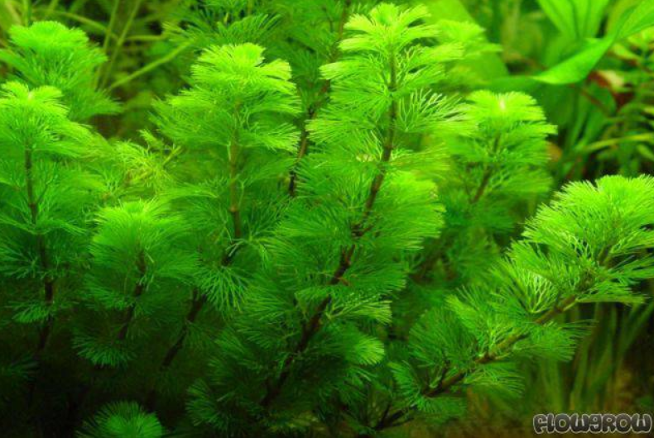
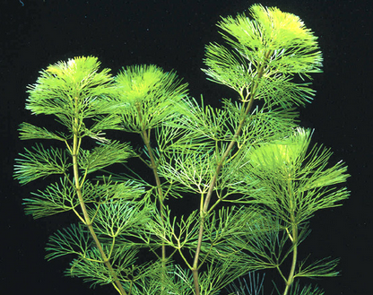
Cabomba
Leaves are divided into fine branches in a fan-like appearance, spanning 2 inches. Floating leaves are small, diamond shape with a emergent white/pinkish flower.
Only found in the cove so far at depths of less than 5 ft.
What to do: Contact lake monitors immediately for professional treatment/removal!
Highly invasive species.

Slide 3
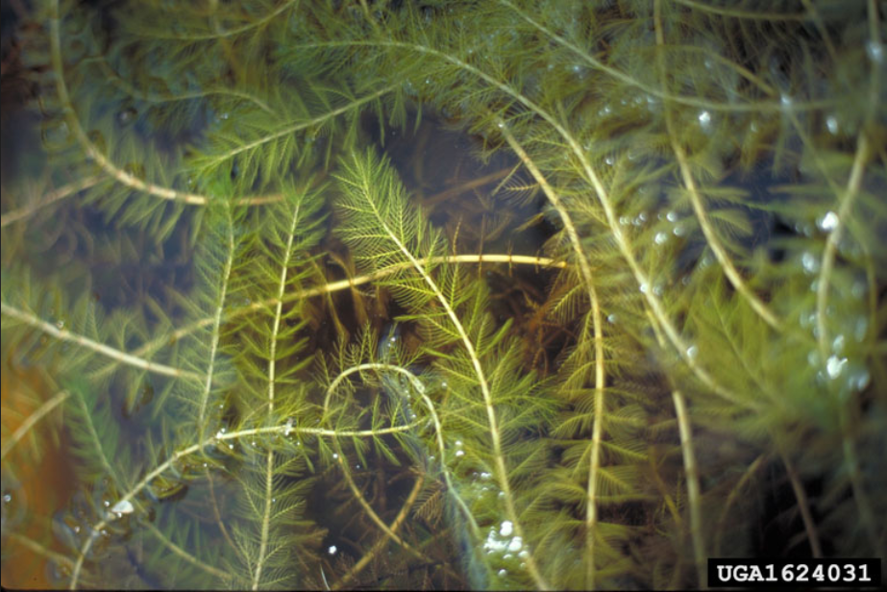
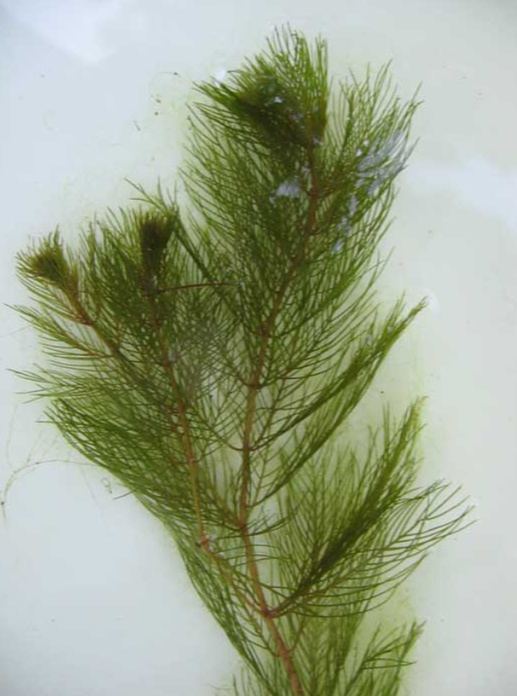
Eurasian Watermilfoil
Can be identified by a pattern of 4 leaves whorled around a hollow stem. Feathery in appearance, each leaf consists of 10-21 pairs of closely packed leaflets.
Found in most areas of the lake.
What to do: Remove plant from lake and discard. If rooted, pull out roots and all. If a large patch, report to lake monitors for treatment.

Slide 4
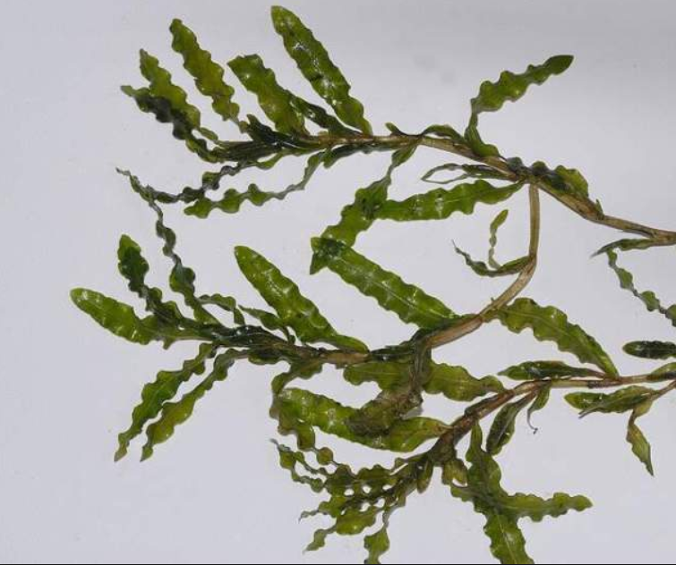
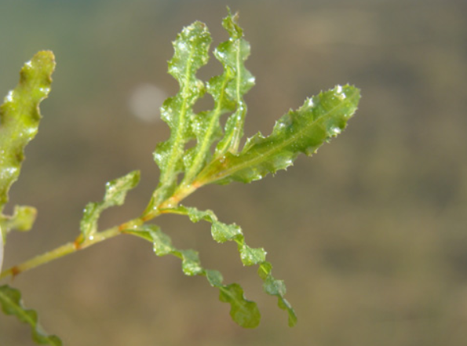
Curlyleaf Pondweed
Found in the lake, mostly shallow areas. Note ‘curly’ leaf shape and serrated saw tooth sides of the leaf that the non-invasive pond weeds do not have.
What to do: Contact lake monitors for treatment.

Slide 5
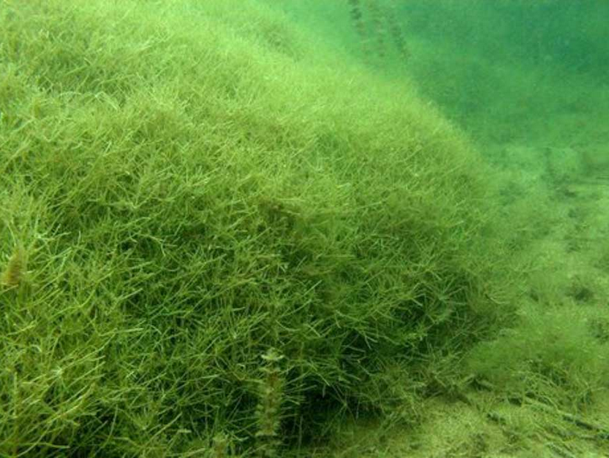
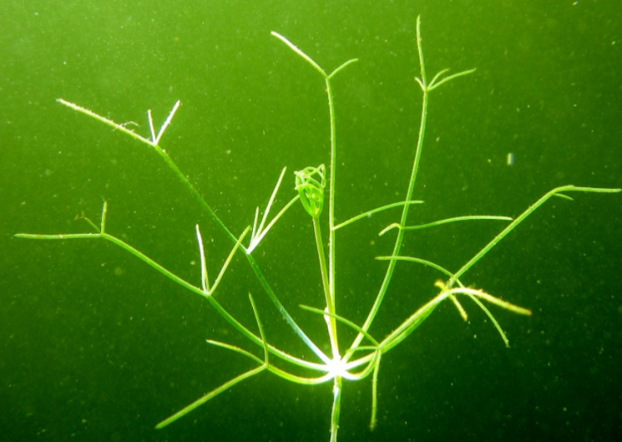
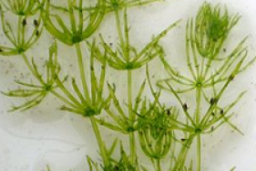
Starry Stonewort
Starry Stonewort
Found in the lake, most areas on bottom. Must look at shoot closely as they are similar to Chara which is healthy for our lake. Note the different ‘leaf’ structure in the pictures to the right.
What to do: Contact lake monitors for treatment.
Chara Algae

Slide 6
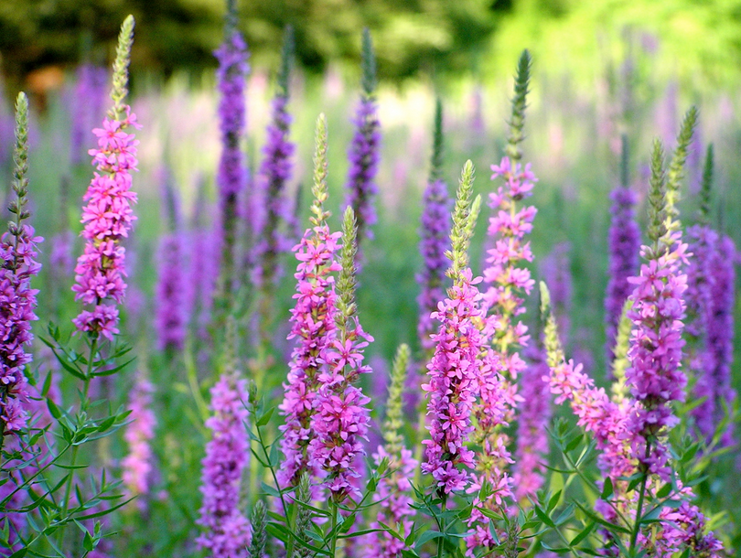
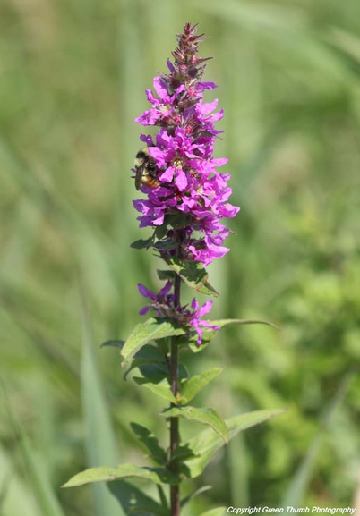
Purple Loosestrife
Found growing near/on shore line. On Big Brower, mostly in the cove.
What to do: Contact lake monitors for treatment.

Slide 7
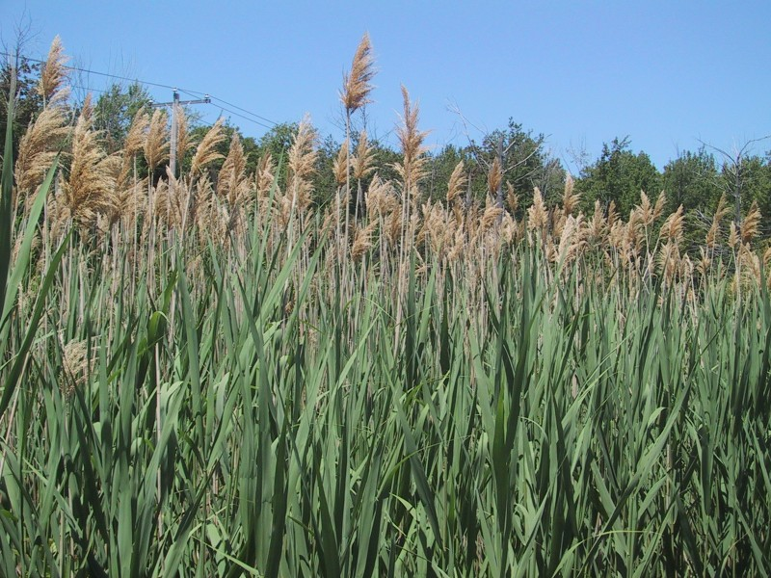
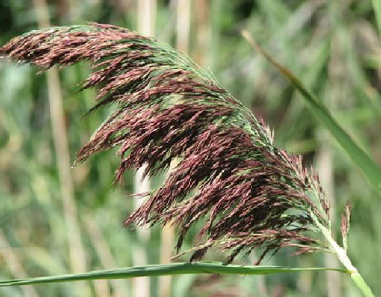
Phragmites
Currently not found growing around Big Brower Lake. Phragmites (common reed) is a wetland grass that ranges in height from 6 to 15 feet tall. It quickly becomes the dominant feature in aquatic ecosystems, aggressively invading shorelines, wetlands, and ditches. This plant creates dense “strands” - walls of weeds crowding out beneficial native wetland vegetation and indigenous waterfowl habitats. Spreading by fragmentation and an extensive root system, Phragmites ultimately out-competes native plant life for sun, water and nutrients.
What to do: Contact lake monitors immediately if found.

Slide 8
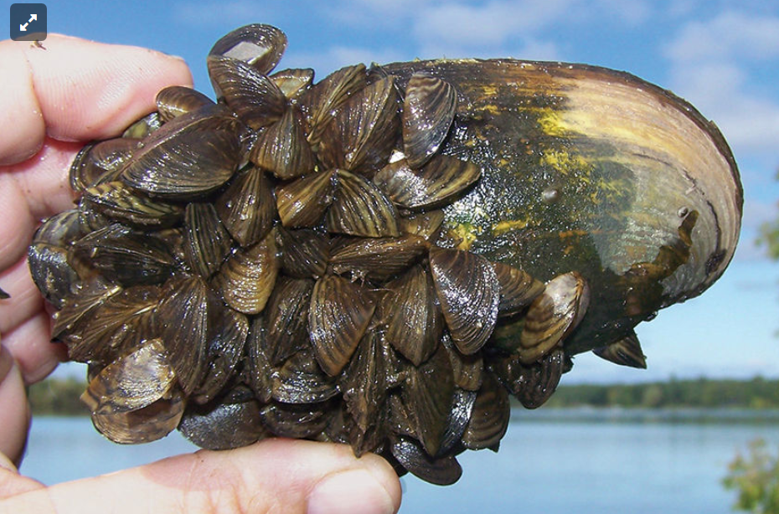
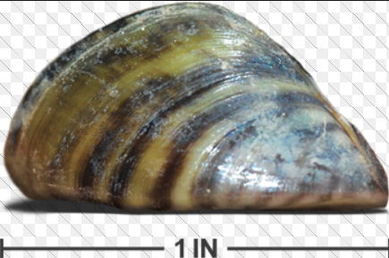
Zebra Mussles
Found attached to solid objects in the lake (dock supports, boat hulls, cement sea walls, anchors, etc.).
What to do: First, CRY-Seriously. Contact a lake monitor immediately. Unable to eradicate from the lake once transplanted and they completely imbalance the lake environment for both indigenous plant life and water creatures. They also create a serious hindrance to recreational lake use as their shells are sharp (swim shoes required where beds exist) and they attach to anything in the water. We MUST prevent transplanting to Big Brower Lake by following the guidelines per the DEQ on the next slide!

Slide 9
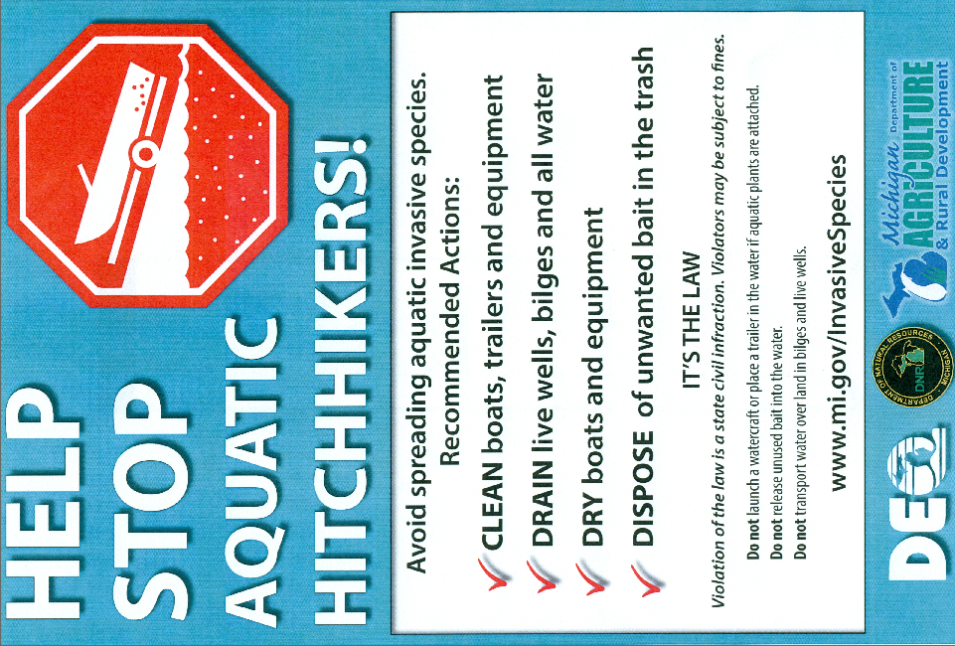

Slide 10

Non-Invasive species we manage
(as needed when growth becomes/creates a recreational nuisance) on
Big Brower Lake
Lake quality monitors: Frank Walejewski dactdp@yahoo.com
Ingrid Jensen ijensen@clarkhill.com
Jerry Peterson jerrypeterson8893@gmail.com

Slide 11
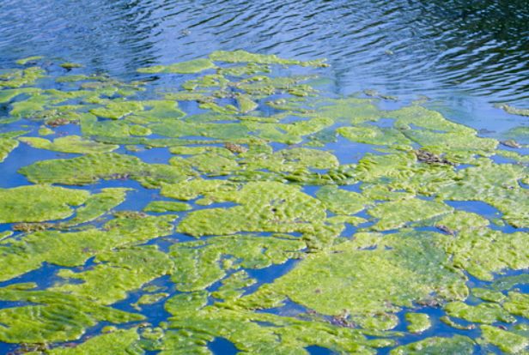
Algae
Found floating in the lake in any area. Can also be a gelatinous glob beneath the surface.
What to do: Contact lake monitors for spot treatment. (Inexpensive)

Slide 12
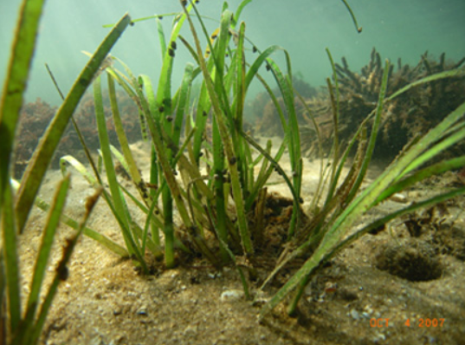
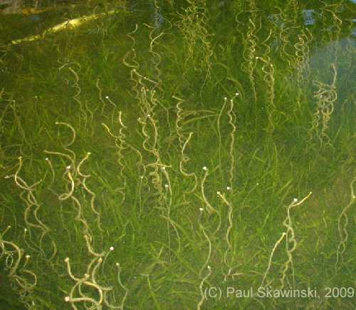
Eel Grass
Found growing around the lake in more shallow areas around shore. The spiral blossoms that come to the surface in August can be a nuisance. Indigenous to the lake so only treated to kill off the tops of the plants when a hindrance to recreational water use.
What to do: Contact lake monitors for spot treatment.

Slide 13
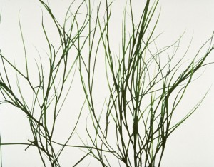
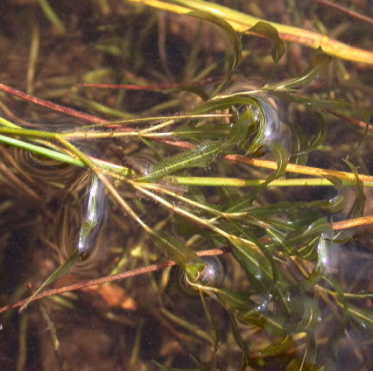
Non-Invasive Pond Weeds
Thinleaf Pondweed
Variable Leaf Pondweed
Found growing around the lake in more shallow areas around shore. Indigenous to the lake so only treated to kill off the tops of the plants when a hindrance to recreational water use.
What to do: Contact lake monitors for spot treatment.

